Slide 1
Final project presentation
Ayyub & Matija

Slide 2
two player puzzle game
INTRODUCTION:
players control two different characters
coordinating mechanism

Slide 3
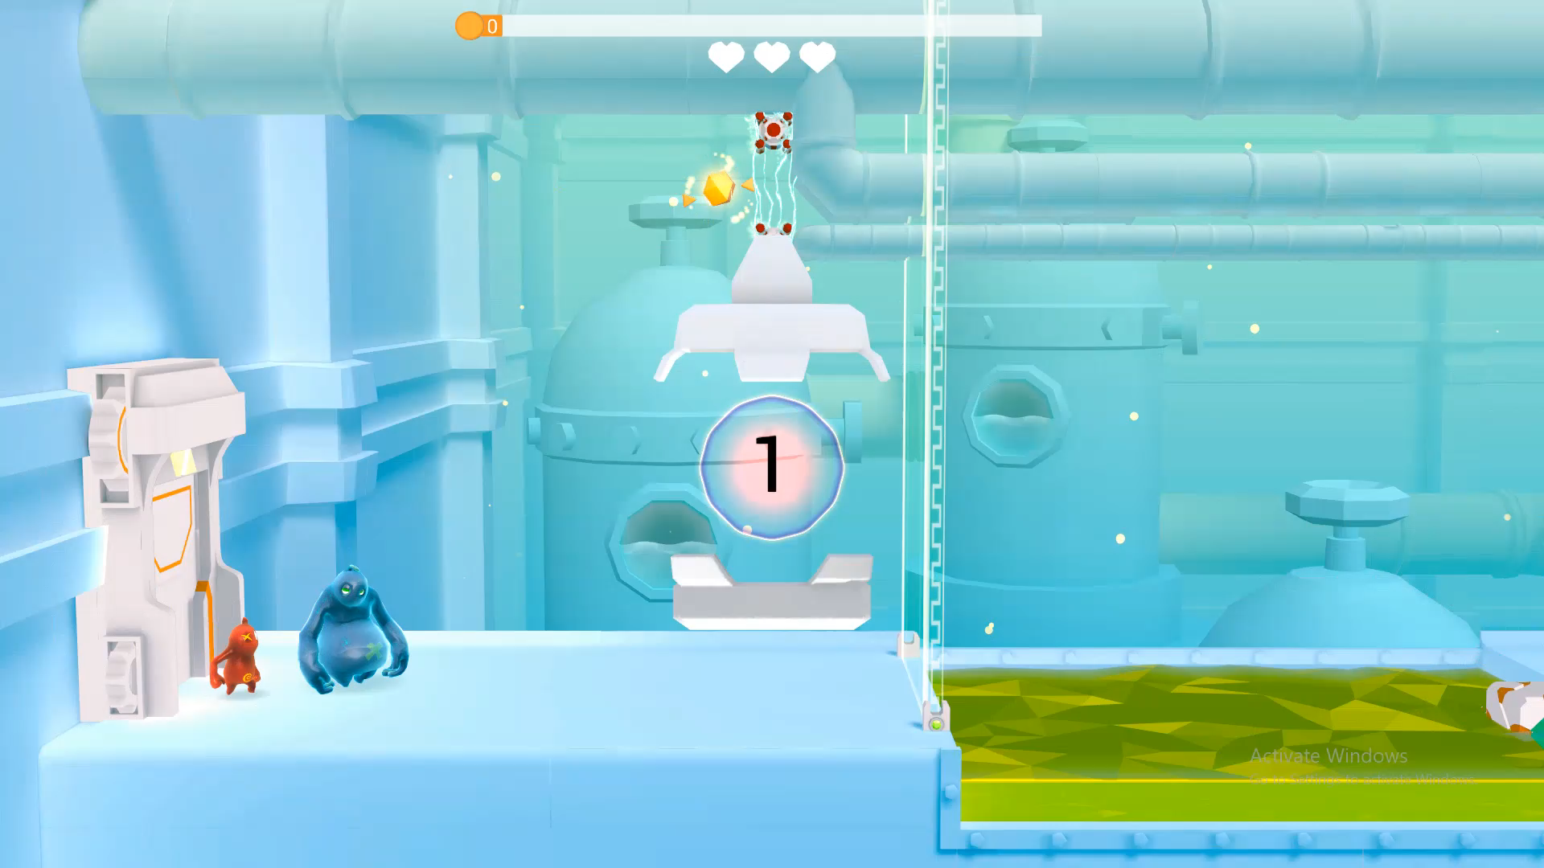
example_1:

Slide 4
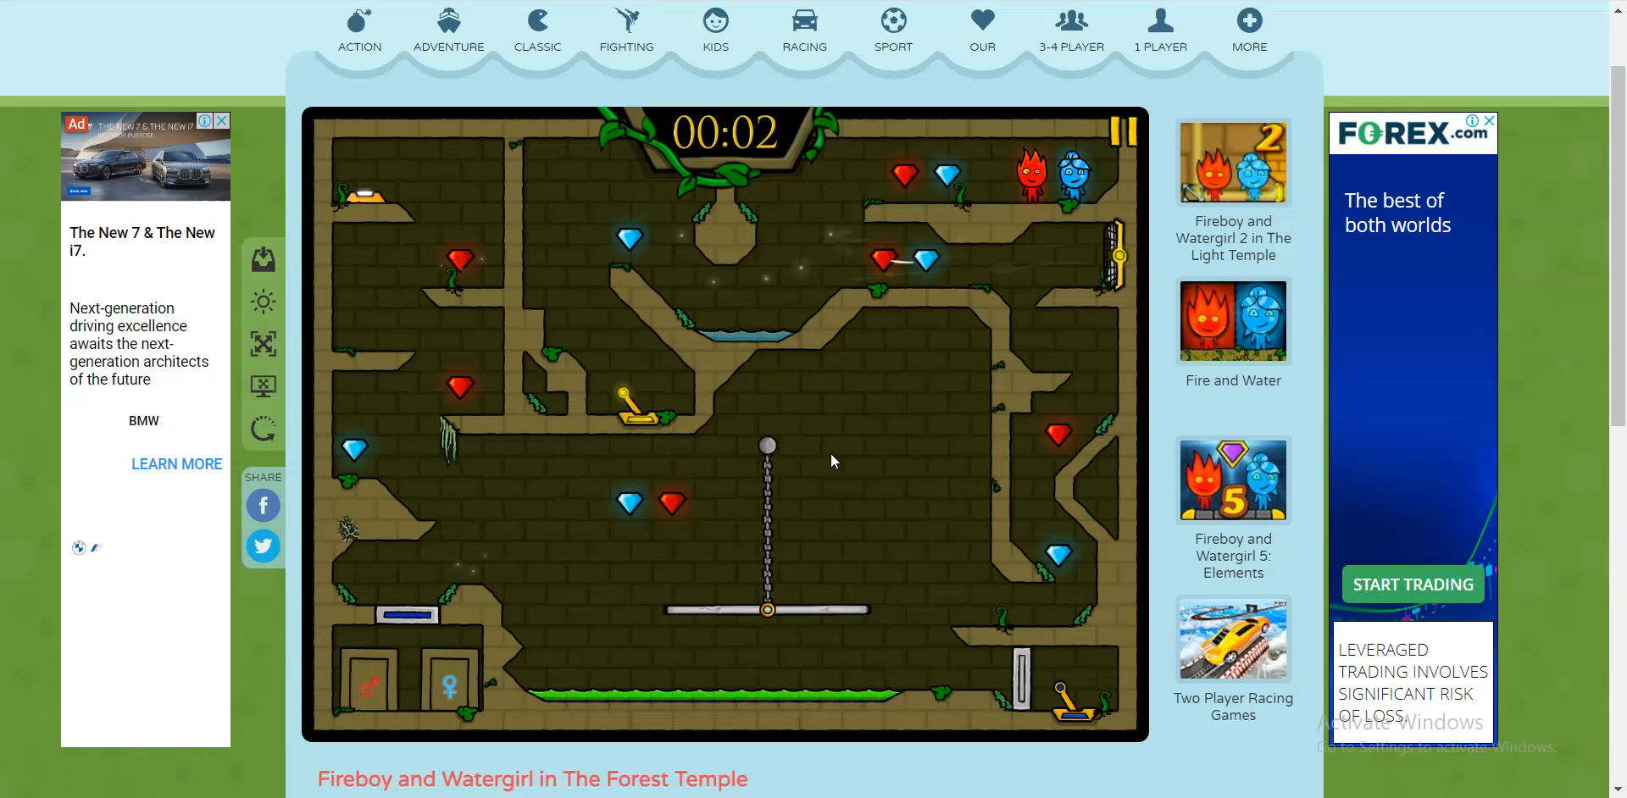
example_2:

Slide 5
We won’t be making these games exactly, but something like these puzzle-centered games.

Slide 6
GAME IMPLEMENTATION: - classes for every entity in the game environment (characters, platforms, etc.) - one player uses WASD and the other uses the arrow keys for movement. - one horizontal level (x_shift)

Slide 7
presentation_end == True

